Slide 1
Software Requirements Engineering
Data Analysis and Quality Attributes
Notes:
<number>

Slide 2
Where are we?
Specifying Data Requirements
Data Model
Entity Relationship Diagram
Class Diagram
Data Dictionary
Data Analysis
Reporting Requirements

Slide 3
Data Analysis
When performing data analysis, you can map various information representations against one another to find gaps, errors, and inconsistencies.
A CRUD matrix is a rigorous data analysis technique for detecting missing requirements.
CRUD stands for Create, Read, Update, and Delete.
A

Slide 4
Data Analysis Using CRUD Matrix

Slide 5
Report Requirements
Many applications generate reports from one or more databases, files, or other information sources.
Exploring the content and format of the reports needed is an important aspect of requirements development.

Slide 6
Eliciting reporting requirements
A BA might ask following question to identify the reports needed.
What reports do you currently use?
Which existing reports need to be modified?
Which reports are currently generated but are not used?
Can you describe any departmental, organizational, or government standards to which reports must conform, such as to provide a consistent look and feel or to comply with a regulation?

Slide 7
Eliciting reporting requirements
Questions about the context and usage of the report
What is the name of the report?
What is the purpose or business intent of the report? How do the recipients of the report use the information? What decisions will be made from the report, and by whom?
Is the report generated manually? If so, how frequently and by which user classes?
Is the report generated automatically? If so, how frequently and what are the triggering conditions or events?
What are the typical and maximum sizes of the report?
Is there a need for a dashboard that would display several reports and/or graphs? If so, must the user be able to drill down or roll up any of the dashboard elements?
What is the disposition of the report after it is generated? Is it displayed on the screen, sent to a recipient, exported to a spreadsheet, or printed automatically? Is it stored or archived somewhere for future retrieval?
Are there security, privacy, or management restrictions that limit the access of the report to specific individuals or user classes, or which restrict the data that can be included in the report depending on who is generating it? Identify any relevant business rules concerning security.

Slide 8
Eliciting reporting requirements
Questions about the report itself:
What are the sources of the data and the selection criteria for pulling data from the repository?
What parameters are selectable by the user?
What calculations or other data transformations are required?
What are the criteria for sorting, page breaks, and totals?
How should the system respond if no data is returned in response to a query when attempting to generate this report?
Can this report be used as a template for a set of similar reports?

Slide 9
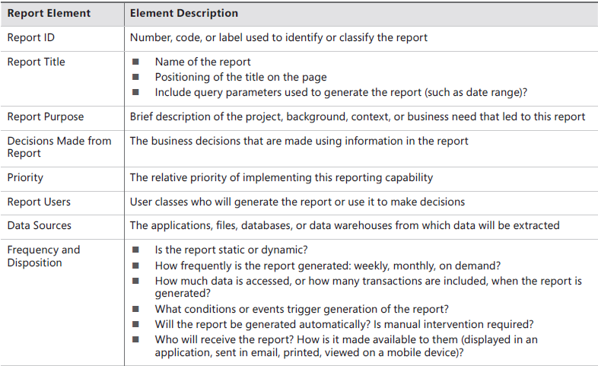
A report specification template

Slide 10
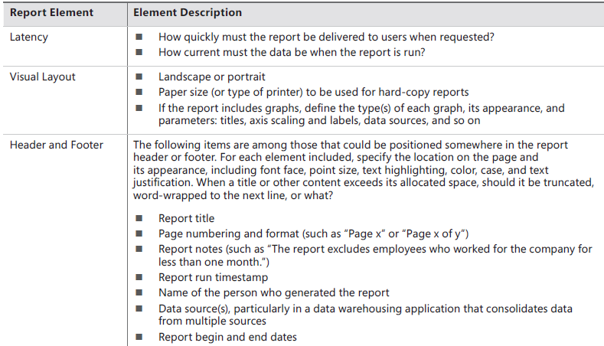
A report specification template

Slide 11
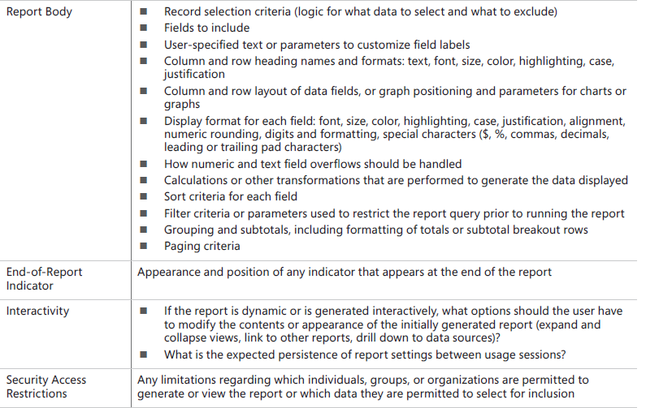
A report specification template

Slide 12
Software Quality Attributes
There’s more to software success than just delivering the right functionality.
Users also have expectations, often unstated, about how well the product will work.
Such expectations include
how easy it is to use,
how quickly it executes,
how rarely it fails,
how it handles unexpected

Slide 13
Non-functional Requirements
Such characteristics, collectively known as quality attributes, quality factors, quality requirements, quality of service requirements, or the “–ilities,” constitute a major portion of the system’s nonfunctional requirements.
Two other classes of nonfunctional requirements are
Constraints

Slide 14
Classification of Quality Attributes
External Quality Attributes
Those characteristics that are discernible through execution of the software
Primarily important to users
Internal qualities
are more significant to development and maintenance staff.
Internal

Slide 15
External Quality Attributes
Availability
The extent to which the system’s services are available when and where they are needed
Installability
How easy it is to correctly install, uninstall, and reinstall the application
Integrity
The extent to which the system protects against data inaccuracy and loss
Interoperability
How easily the system can interconnect and exchange data with other systems or components
Performance
How quickly and predictably the system responds to user inputs or other events

Slide 16
External Quality Attributes
Reliability
How long the system runs before experiencing a failure
Robustness
How well the system responds to unexpected operating conditions
Safety
How well the system protects against injury or damage
Security
How well the system protects against unauthorized access to the application and its data
Usability
How easy it is for people to learn, remember, and use the system

Slide 17
Internal Quality Attributes
Efficiency
How efficiently the system uses computer resources
Modifiability
How easy it is to maintain, change, enhance, and restructure the system
Portability
How easily the system can be made to work in other operating environments
Reusability
To what extent components can be used in other systems
Scalibility
How easily the system can grow to handle more users, transactions, servers, or other extensions
Verifiability
How readily developers and testers can confirm that the software was implemented correctly

Slide 18
Where are we?
Specifying Data Requirements
Data Model
Entity Relationship Diagram
Class Diagram
Data Dictionary
Data Analysis
Reporting Requirements

Slide 19
Data Analysis
When performing data analysis, you can map various information representations against one another to find gaps, errors, and inconsistencies.
A CRUD matrix is a rigorous data analysis technique for detecting missing requirements.
CRUD stands for Create, Read, Update, and Delete.
A

Slide 20
Data Analysis Using CRUD Matrix

Slide 21
Report Requirements
Many applications generate reports from one or more databases, files, or other information sources.
Exploring the content and format of the reports needed is an important aspect of requirements development.

Slide 22
Eliciting reporting requirements
A BA might ask following question to identify the reports needed.
What reports do you currently use?
Which existing reports need to be modified?
Which reports are currently generated but are not used?
Can you describe any departmental, organizational, or government standards to which reports must conform, such as to provide a consistent look and feel or to comply with a regulation?

Slide 23
Eliciting reporting requirements
Questions about the context and usage of the report
What is the name of the report?
What is the purpose or business intent of the report? How do the recipients of the report use the information? What decisions will be made from the report, and by whom?
Is the report generated manually? If so, how frequently and by which user classes?
Is the report generated automatically? If so, how frequently and what are the triggering conditions or events?
What are the typical and maximum sizes of the report?
Is there a need for a dashboard that would display several reports and/or graphs? If so, must the user be able to drill down or roll up any of the dashboard elements?
What is the disposition of the report after it is generated? Is it displayed on the screen, sent to a recipient, exported to a spreadsheet, or printed automatically? Is it stored or archived somewhere for future retrieval?
Are there security, privacy, or management restrictions that limit the access of the report to specific individuals or user classes, or which restrict the data that can be included in the report depending on who is generating it? Identify any relevant business rules concerning security.

Slide 24
Eliciting reporting requirements
Questions about the report itself:
What are the sources of the data and the selection criteria for pulling data from the repository?
What parameters are selectable by the user?
What calculations or other data transformations are required?
What are the criteria for sorting, page breaks, and totals?
How should the system respond if no data is returned in response to a query when attempting to generate this report?
Can this report be used as a template for a set of similar reports?

Slide 25
A report specification template

Slide 26
A report specification template

Slide 27
A report specification template

Slide 28
Software Quality Attributes
There’s more to software success than just delivering the right functionality.
Users also have expectations, often unstated, about how well the product will work.
Such expectations include
how easy it is to use,
how quickly it executes,
how rarely it fails,
how it handles unexpected

Slide 29
Non-functional Requirements
Such characteristics, collectively known as quality attributes, quality factors, quality requirements, quality of service requirements, or the “–ilities,” constitute a major portion of the system’s nonfunctional requirements.
Two other classes of nonfunctional requirements are
Constraints

Slide 30
Classification of Quality Attributes
External Quality Attributes
Those characteristics that are discernible through execution of the software
Primarily important to users
Internal qualities
are more significant to development and maintenance staff.
Internal

Slide 31
External Quality Attributes
Availability
The extent to which the system’s services are available when and where they are needed
Installability
How easy it is to correctly install, uninstall, and reinstall the application
Integrity
The extent to which the system protects against data inaccuracy and loss
Interoperability
How easily the system can interconnect and exchange data with other systems or components
Performance
How quickly and predictably the system responds to user inputs or other events

Slide 32
External Quality Attributes
Reliability
How long the system runs before experiencing a failure
Robustness
How well the system responds to unexpected operating conditions
Safety
How well the system protects against injury or damage
Security
How well the system protects against unauthorized access to the application and its data
Usability
How easy it is for people to learn, remember, and use the system

Slide 33
Internal Quality Attributes
Efficiency
How efficiently the system uses computer resources
Modifiability
How easy it is to maintain, change, enhance, and restructure the system
Portability
How easily the system can be made to work in other operating environments
Reusability
To what extent components can be used in other systems
Scalibility
How easily the system can grow to handle more users, transactions, servers, or other extensions
Verifiability
How readily developers and testers can confirm that the software was implemented correctly

